Slide 1
Agentic AI Hackathon: Building Intelligent Agents with IBM Granite and LangFlow

Slide 2

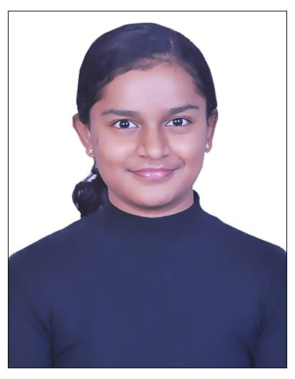
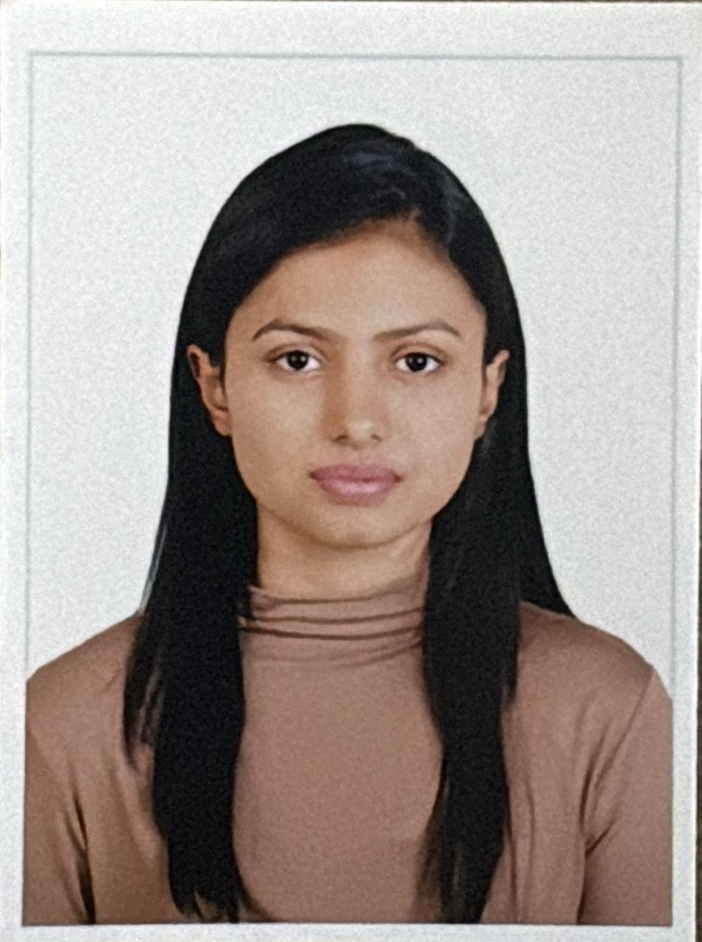
Name of the team: CodeBLUE Agents
Details of Team members
TEAM MEMBER NAME | Recent Passport Photo | Email ID | Phone number [WhatsApp]
Aarush Ajay |  | aarushajay.bs23@bmsce.ac.in | 7259644069
Asitha Ramesh |  | asitharamesh.bs23@bmsce.ac.in | 9902312205
Shreyaa G |  | shreyaag.bs23@bmsce.ac.in | 9900382133

Slide 3
Problem statement
Chronic Disease Management Assistant
The Challenge
Patients with chronic conditions such as diabetes, hypertension, and asthma generate daily health data through self-monitoring devices and logs. Healthcare professionals cannot continuously analyze this growing volume of patient-generated data due to time and resource constraints. As a result, early warning signs of health deterioration may be missed, leading to delayed interventions and increased risk of complications. There is a need for an intelligent assistive system that can continuously analyze health logs and support proactive chronic disease management.
Health Data Analysis Agent
An agent that ingests daily patient health data such as blood glucose levels, blood pressure readings, peak flow values, and medication adherence logs, and organizes them into meaningful health trends.
Risk Trend Detection Agent
An agent that analyzes short-term and long-term health trends to identify abnormal patterns or potential deterioration using clinical thresholds and historical data.
Alert & Lifestyle Recommendation Assistant
An agent that generates early warning alerts and provides lifestyle and care recommendations aligned with clinical best practices (assistive only, non-diagnostic).

Slide 4
Proposed solution
This is an Agentic AI system built on IBM Granite that transforms raw patient data into actionable health insights.
Multi-Agent Architecture: Uses a chain of specialized agents to summarize data, detect clinical risks, and provide guidance.
Rule-Based Logic: Integrates medical thresholds (e.g., blood pressure ≥ 140/90) with Generative AI to ensure objective monitoring.
Non-Diagnostic Guidance: Delivers early-warning alerts and lifestyle advice grounded in clinical guidelines via RAG (Retrieval-Augmented Generation).
Real-Time Processing: Converts daily logs into explainable trends, reducing the time between health deterioration and clinical intervention.

Slide 5
Need of project
Combatting "Data Fatigue": Healthcare providers cannot manually review the millions of data points generated daily by patient self-monitoring devices.
Early Intervention: Bridges the gap between doctor visits by identifying silent worsening of conditions (like rising glucose levels) before they become emergencies.
Patient Empowerment: Helps patients understand their own data, explaining why a trend is risky and what lifestyle changes can help.
Resource Optimization: Reduces hospital readmissions and emergency room visits by enabling proactive, home-based management.

Slide 6
End user of project
Chronic Disease Patients: Individuals managing Diabetes, Hypertension, or Asthma who need daily feedback on their self-monitoring logs.
Family Caregivers: People monitoring the health of elderly parents or children who require an "early warning system" for peace of mind.
Healthcare Providers: Doctors and nurses who need a summarized, high-priority "Risk Dashboard" instead of scrolling through thousands of raw logs.
Health Coaches/Wellness Programs: Professionals looking for automated tools to support patient adherence and lifestyle modification.

Slide 7
Technology Used
Langflow platform
Langflow component name – Agent , Chat input , Chat output
IBM Grainte model - ibm-granite-3-2-8b
IBM Cloud
RAG
IBM Watsonx.ai
Watsonx

Slide 8
Novelty and Uniqueness
Multi-Agent Collaborative Reasoning: Instead of one LLM trying to do everything, we use a "Chain of Experts." One agent focuses solely on data trends, while another applies medical rules, ensuring much higher precision.
Rule-Grounded Generative AI: Unlike standard AI that can be vague, CareWatch combines Generative AI with Hard Clinical Thresholds (e.g., specific blood pressure and glucose numbers). It only triggers alerts when objective medical limits are crossed.
Explainable Early Warnings: Most monitoring tools just show a graph. CareWatch provides a "Reasoning Layer," telling the patient exactly why they are at risk (e.g., "Your glucose rose 20% over 4 days while you missed 2 medication doses").
Assistive, Non-Diagnostic Design: It is specifically engineered to be a "Doctor's Assistant," not a "Doctor Replacement." The built-in guardrails and RAG-based context ensure it stays within safe, non-diagnostic boundaries.
Native IBM Stack Integration: Fully optimized for the IBM ecosystem, leveraging Granite’s unique strengths in enterprise-grade, rule-following tasks within the watsonx environment.
·

Slide 9
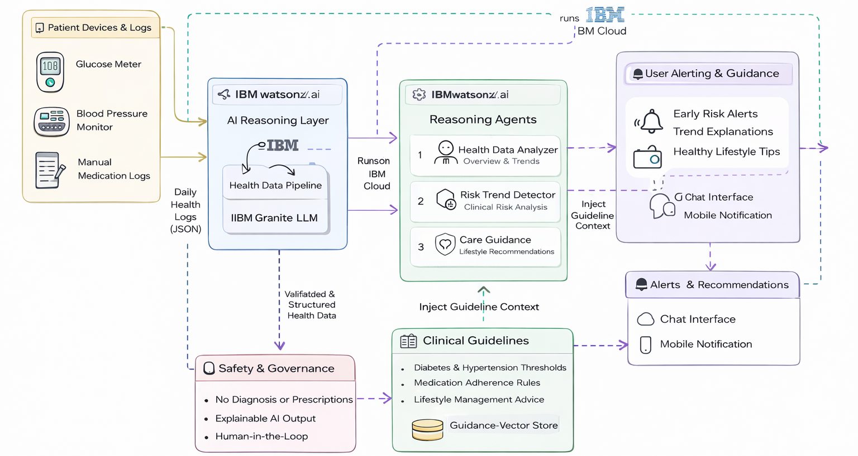
Technical flow diagram - Architecture blueprint

Slide 10
Langflow component Used
1) Chat Input The entry point of the system. It captures the patient's raw health logs (JSON data) and any user queries to start the analysis process.
2) IBM watsonx AI Agent The processing engine. It uses the IBM Granite model to reason through data. In this project, multiple agents work in a chain to summarize trends, check clinical rules (e.g., BP thresholds), and generate advice.
3) File Component The knowledge uploader. It allows the system to read external medical guidelines (PDF/Text). This is the foundation of the RAG setup, ensuring the AI's advice is based on facts, not guesses.
4) Chat Output The interface. It displays the final results—such as the Early Warning Alert and Lifestyle Recommendations—in a clean, readable format for the user.
5)Other Components Used
IBM watsonx.ai (Model Node): The connection hub that links Langflow to the Granite-3.2-8b model using your IBM Cloud API credentials.
Prompt Template: The instruction set that tells the agents exactly how to behave (e.g., "Analyze this data as a medical assistant").

Slide 11
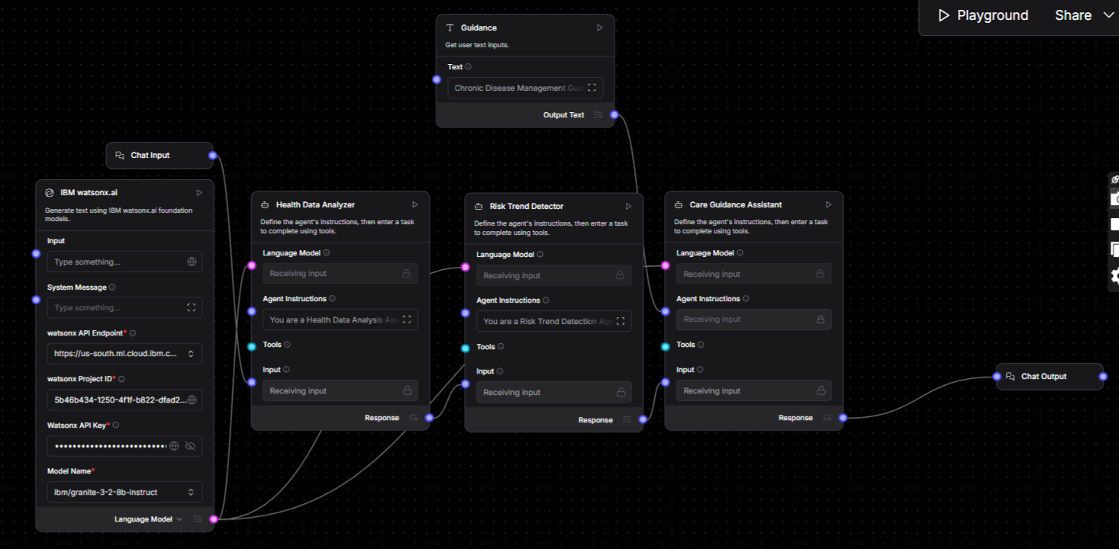
Input Screenshot 1

Slide 12
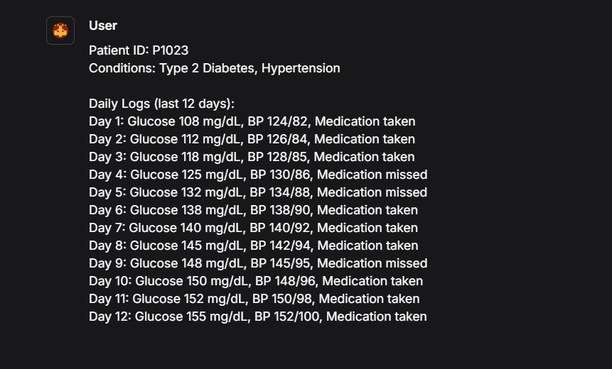
Input Screenshot 2

Slide 13
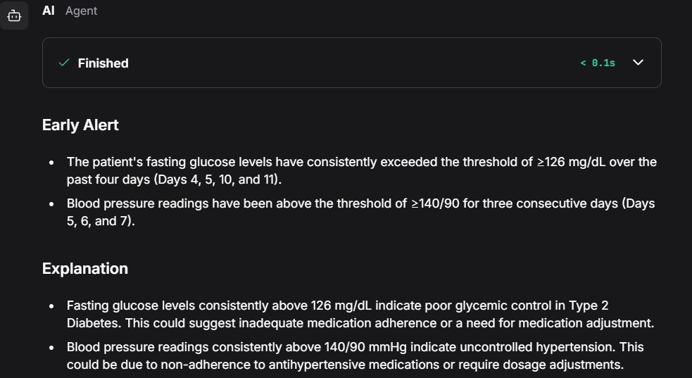
Output Screenshot 1

Slide 14
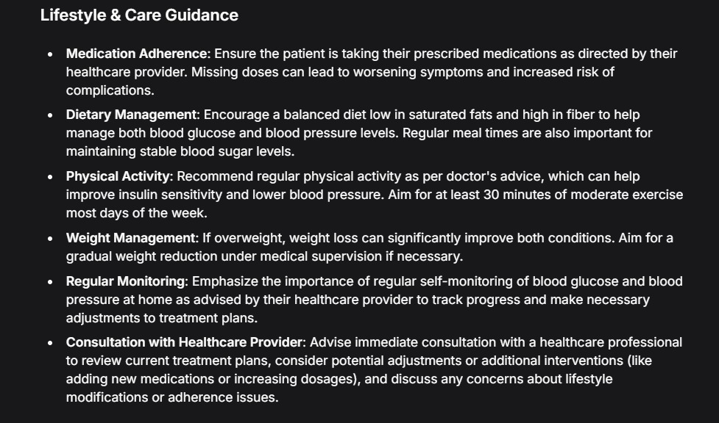
Ouput Screenshot 2

Slide 15
Future Scope
Real-Time Wearable Syncing: Automating data collection by integrating with CGMs, smartwatches, and inhalers to eliminate manual logging and capture "invisible" health metrics.
Predictive AI Forecasting: Shifting from reactive alerts to proactive forecasting, using IBM Granite to predict health crises (like hypertensive spikes) before they occur based on sleep and stress trends.
Automated Clinician Triage: Creating a direct link to healthcare providers that automatically flags high-risk patients, allowing doctors to prioritize those in urgent need of intervention.
Environmental Trigger Analysis: Incorporating external data like air quality and pollen counts to warn patients when environmental factors might aggravate their specific condition.

Slide 16
Git Hub Link
https://github.com/Aarush-Ajay/Chronic-Disease-Management-Assistant.git
·
·
·

Slide 17
References
World Health Organization (WHO) – Chronic Disease Guidelines
American Diabetes Association (ADA) – Diabetes Care Standards
American Heart Association (AHA) – Hypertension Guidelines
IBM Watsonx.ai & LangFlow Official Documentation
·
·
·

Slide 18


